Slide 1
Doomsday Team No: Doomsday
Members: Joshua Lester

Slide 2

Team Details
Name: Joshua Lester
Year: Senior

Slide 3
Project Overview
There are many YouTubers online that manually create color coded rhyme scheme videos on their channels
This project aims to automate this process
The main requirement is color coding a given set of lyrics
Based on their pronunciation and proximity to other similarly pronounced syllables and words

Slide 4
Requirements List
R1: There will be a feature to intake lyrics
R2: There will be a feature to algorithmically map colors to similar words/syllables
R3: there will be a feature to color each syllable individually and output it to the user
R4: There will be a feature to divide the lyrics into lines, words, syllables, and then into pronunciation for better analyzation. This feature will rely on a pronunciation dictionary.
R5: There will be a feature to intake lyrics through the command line as a file. This feature will use another software tool for reading files
R6: There will be a feature to store words from pronouncing dictionary and past words inputted and rhymes found into storage in the app.

Slide 5
Project Solution Approach
What are the major components in your solution design?
CLI Tool
C# backend to run algorithm
What are the tools, frameworks, platforms, libraries, etc. that you’ll be using
Textual - python markup for console (colors, panels, etc.)
SQLite - to store rhymes and pronunciations
Entity Framework Core - to connect to SQLite db through code (ORM)

Slide 6
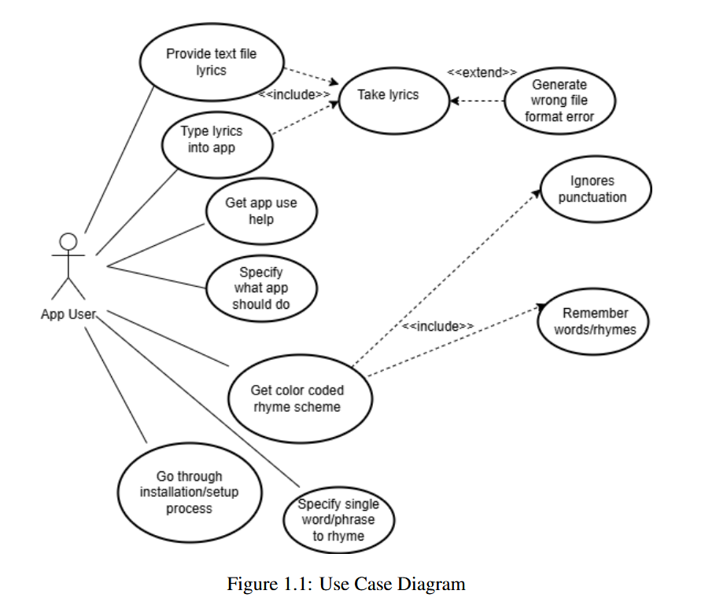
Use Case Modeling

Slide 7
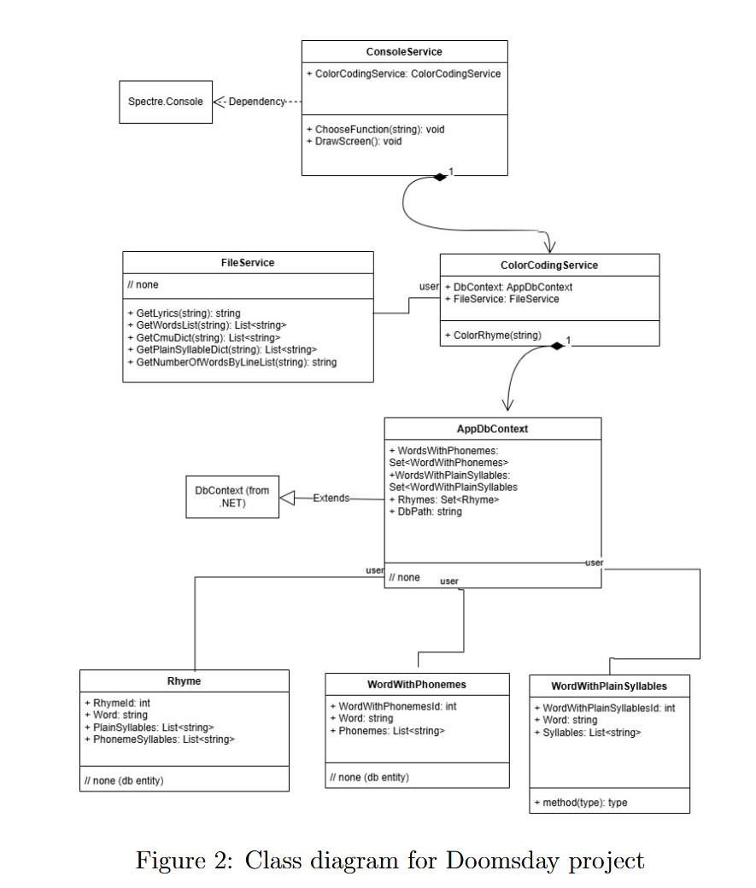
Structural Modeling (Class Diagram)

Slide 8
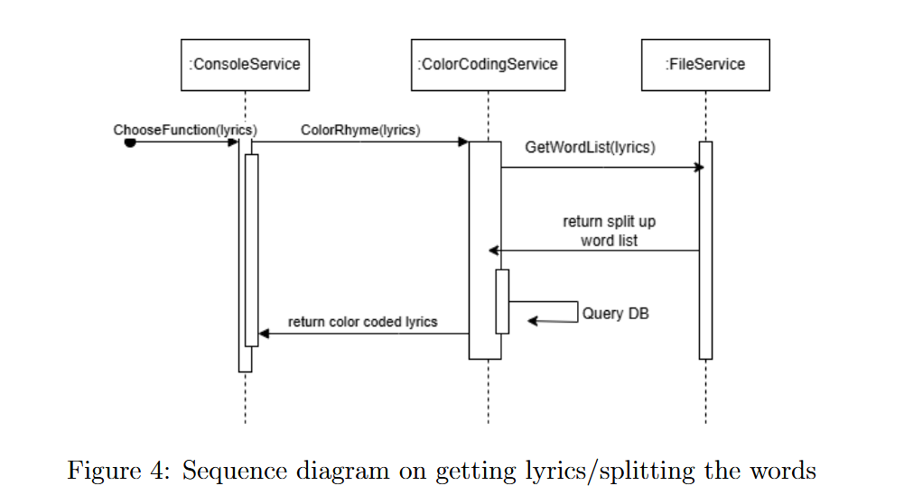
Behavioral Modeling (Sequence Diagram)

Slide 9
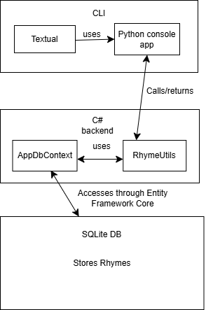
System Architecture

Slide 10
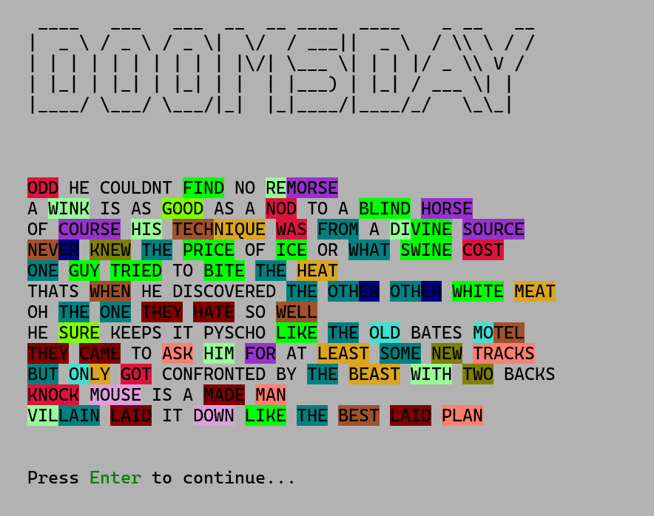
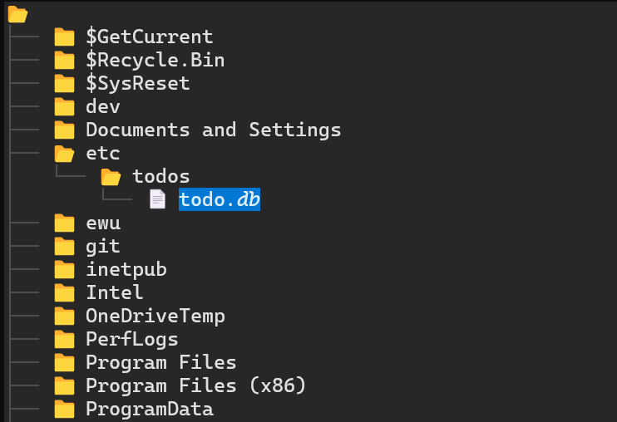
Screenshots (UI)

Slide 11
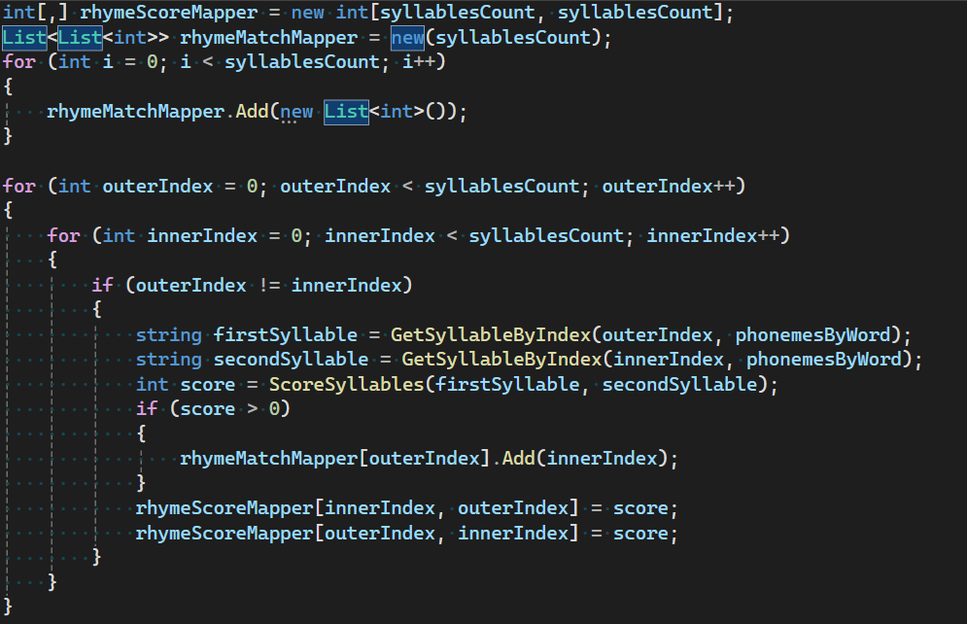
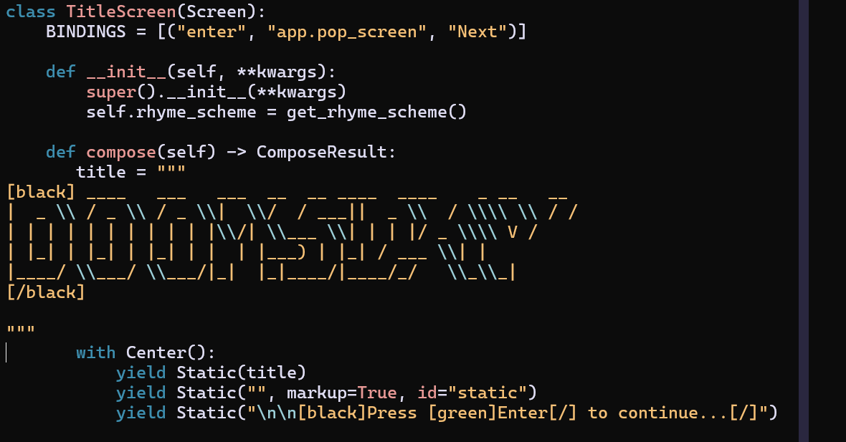
Screenshots (Code)

Slide 12
Test Cases
FileUtils
Test getLyrics()
Test getWordsList
Test getCmuDict
Test getPlainSyllableDict
For the above, test input, null input, and that correct functionality occurs
RhymeUtils
Integration test the entire process of color coding rhyme schemes

Slide 13
Demo
Switch to app now :)

Slide 14
Challenges
Learning new frameworks (Textual, having to switch from Spectre.Console after studying it for a couple of days)
Testing (especially integration testing)
Working with Textual and trying to make the application look nice
Having Python app call a .NET Application (went through several different solutions including pythonnet, calling .NET exe from Python, etc.)
Having .NET application (even though it’s in a separate directory from Python app) call the correct path for finding a file

Slide 15
Conclusion
Still a work in progress, but will continue to work on it to develop into a fully fledged app that YouTubers can use
Future plans:
Add voice recognition so songs (.mp4, .wav files) can be inputted or recording can be sung into to color code rhyme scheme
Possibly port into easier to use application than console app (for non-technical users)
Add ability to color code over time (live) to replicate manual-made YouTube videos

Slide 16
GitHub and YouTube Video Link for Demo
GitHub: https://github.com/Sanmeet-EWU/cscd-350-project-doomsday
YouTube Demo Link: https://youtu.be/tAFItwM57q0

Slide 17
References
https://textual.textualize.io/
https://learn.microsoft.com/en-us/ef/core/
https://www.sqlite.org/

